Slide 1
Applied Data Science with Microsoft Fabric
Tomaž Kaštrun, MVP

Slide 2
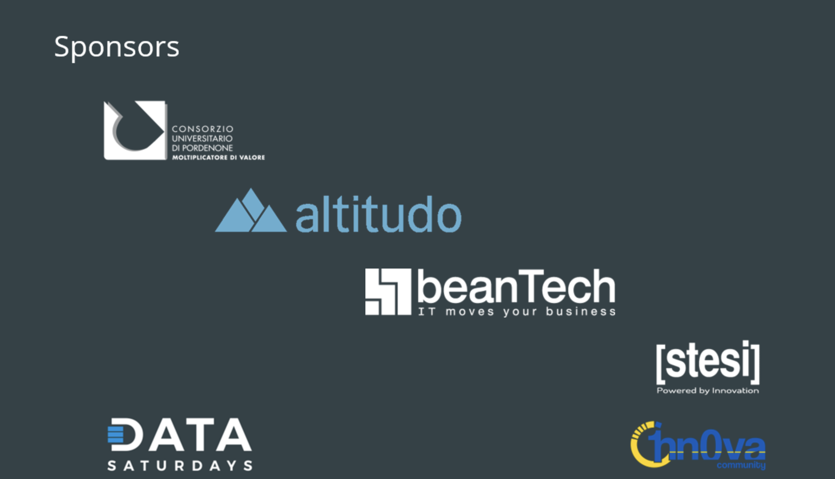

Slide 3

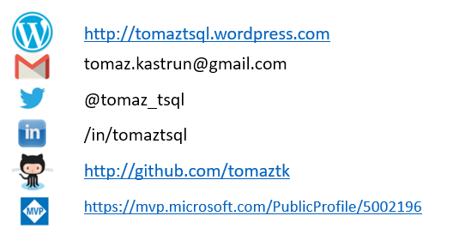
About
Data scientist | BI Developer | Data Analyst
SQL Server, SAS, R, Python, C#, SAP, SPSS
20+years experience MSSQL, DEV, BI, DM, DS
Frequent community speaker, book author
Avid coffee drinker & bicycle junkie
Session material: github.com/tomaztk/microsoft-fabric

Slide 4
Agenda
Fabric in General
Tools comparison
Tips from the field + Benchmarking
Demo E2E:
Ingest data
Explore and visualize data (EDA)
Model building
Model registration with MLFlow
API

Slide 5
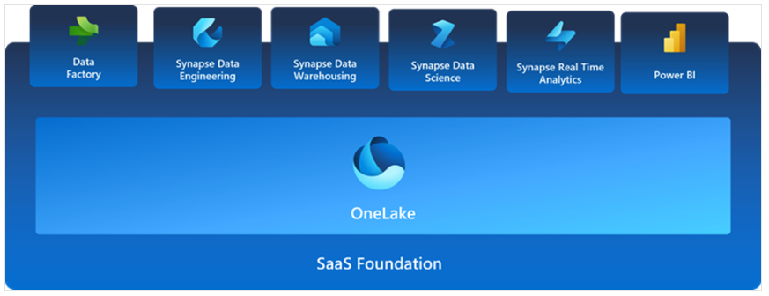
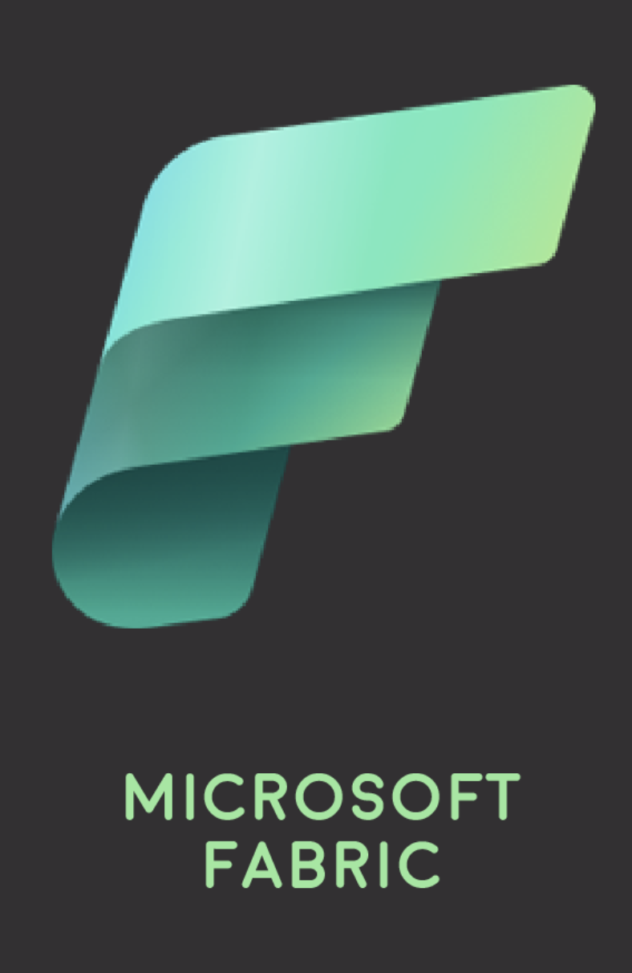
SaaS foundation
“The OneDrive for Data”
Integration provides the following advantages:
- centralized experience, administration and governance across all SaaS
- unified data lake (OneLake) to retain data
- shared experience and familiar environment across the board
- seamless integration and central configuration for all underlying services
- BI developers and data scientists can access and reuse all assets
Notes:
Fabric brings together experiences such as Data Engineering, Data Factory, Data Science, Data Warehouse, Real-Time Analytics, and Power BI onto a shared SaaS foundation.

Slide 6
OneLake for all Data
“The OneDrive for Data”
Data
Warehousing
Data
Engineering
Data Integration
Data
Science
Real
Time
Analytics
Business Intelligence
A single SaaS lake for the whole organization
Provisioned automatically with the tenant
All workloads automatically store their data in the OneLake workspace folders
All the data is organized in an intuitive hierarchical namespace
The data in OneLake is automatically indexed for discovery, MIP labels, lineage, PII scans, sharing, governance and compliance
OneLake Storage
Intelligent data fabric
Notes:
You can think of OneLake as the OneDrive for Data. This is a Software as a Service lake for your whole organization that allows you to access and store data in a single location, so that your Spark jobs can operate against a single of truth and allow you to produce insight and analytics in a unified fashion. This will also allow you to organize your data in an intuitive hierarchal namespace, and enable indexing for discovery using Microsoft Information Protection labels, lineage, and Personally Identifiable information scans to enforce governance and compliance on data stored in the OneLake.

Slide 7
One Copy for all computes
Real separation of compute and storage
Data
Warehousing
Data
Engineering
Data Integration
Data
Science
Real
Time
Analytics
Business Intelligence
All the compute engines store their data automatically in OneLake
The data is stored in a single common format
Delta – Parquet, an open standards format, is the storage format for all tabular data in Fabric
Once data is stored in the lake, it is directly accessible by all the engines without needing any import/export
All the compute engines have been fully optimized to work with Delta Parquet as their native format
Shared universal security model is enforced across all the engines
Serverless
Compute
T-SQL
Spark
KQL
Analysis Services
OneLake Storage
Finance
Customers 360
Service Telemetry
Business KPIs
Delta – Parquet Format
Delta – Parquet Format
Delta – Parquet Format
Delta – Parquet Format
Notes:
Because we use a single copy of data for all compute jobs, whenever we query data stored in OneLake, we’re able to do it in a common way. Tabular data is stored in the open standard Delta-Parquet format where it can be analyzed using optimized compute engines that can directly access this data without the need for additional import or export processes. And of course, the universal security model is enforced across all engines, ensuring that data is accessed securely. Whether a sql query is used by finance or a Spark job for customer data processing, Kusto Query Language for live service telemetry, or Analysis Services for generating business KPIs in a Power BI report. They will all interact with data stored in the Delta-parquet format that is granted access to from the single security layer.

Slide 8



Taking One Copy to the next level
Shortcuts
Sharing data in OneLake is as easy as sharing files in OneDrive, removing the needs for data duplication
With shortcuts, data throughout OneLake can be composed together without any data movement
Shortcuts also allow instant linking of data already existing in Azure and in other clouds, without any data duplication and movement, making OneLake the first multi-cloud data lake
With support for industry standard APIs, OneLake data can be directly accessed by any application or service
Data
Integration
Data
Engineering
Data Warehousing
Real
Time Analytics
Data Science
Business Intelligence
OneLake Storage
Finance
Customers 360
Service Telemetry
Business KPIs
Azure
Amazon
Google
Notes:
Sharing data in OneLake is made easy through the shortcuts feature, this allows you to link to data which may be stored on cloud providers outside of Microsoft Azure without the need for data duplication of movement. This makes OneLake the first multi-cloud datalake. So whether you have data stored in Azure, AWS, or Google Cloud you can make your data available in your OneLake and query those sources using the common query mechanisms described earlier.

Slide 9
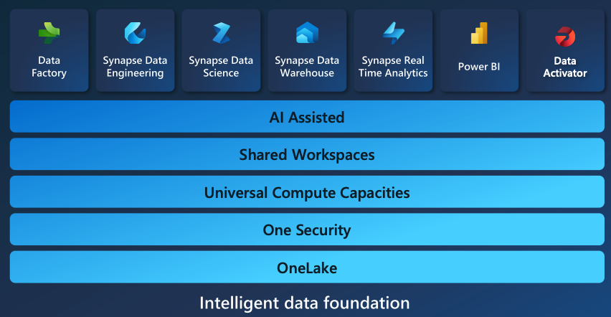
Microsoft Fabric in a gist with “All services”
Source: Microsoft
Notes:
Data factory
The data factory offers in excess of 150 connectors to cloud and on-premise data sources, the ability to orchestrate data pipelines, and drag-and-drop experiences for data transformation.
Synapse data engineering
The data engineering workload has cool features that work within Fabric, such as Lakehouse. A Lakehouse artifact exists within its own workspace and enables what Microsoft describes as “great authoring experiences” using the Spark engine. There are also other cool benefits, such as instant start with live pools and the ability to collaborate.
Synapse data warehouse
The data warehouse workload provides data engineers and analysts with a converged Lakehouse and data warehouse experience. Behind the warehouse is their industry-leading (on open data formats), unified, serverless, and dedicated SQL engine.
Synapse real-time analytics
The real-time analytics workload enables developers to stream data from Internet of Things (IoT) devices, telemetry, logs, and more. They’re also able to analyze large volumes of semi-structured data with high performance and low latency since Kusto Query Langauge (KQL) is at its foundation.
Synapse data science
The Data Science workload enables users to work through the entire end-to-end data science process. It does so by offering data scientists a variety of tools required to build sophisticated AI models, collaborate on projects, and train, deploy, and manage machine learning models.
Data Activator
Data Activator is an intuitive, no-code interface within Microsoft Fabric, designed to autonomously initiate actions in response to identified patterns or specific conditions in evolving data.
Business Intelligence (Power BI)
Sitting at the heart of Fabric's business intelligence workload is Microsoft’s industry-leading and AI-driven analytics service, Power BI. This enables business analysts and other users to discover insights within organizational data. It’s also deeply integrated with Microsoft 365, which means organizations can gain relevant insights directly from any of the 365 products

Slide 10
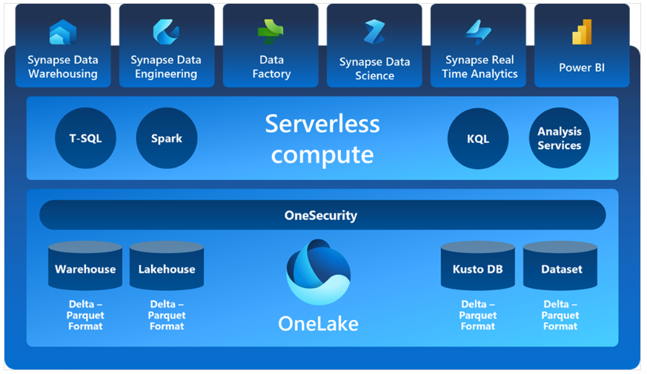
OneLake and lakehouse
Where home is!
Unified location!
- Built on top of ADLS Gen2
- Tenant-wide store
- One security with “one drive” feels like
- Simplifies for end user, with no need to “understand” the resource groups, RBAC, Resource manager, redundancy policies and regions
seamless integration and central configuration for all underlying services

Slide 11
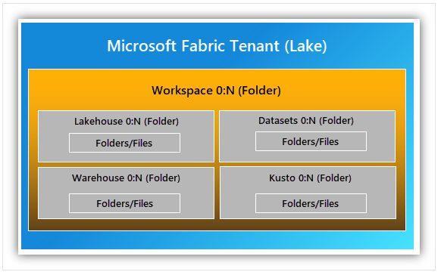
OneLake organisation
- is hierarhical and there is no
need to up-front provisioning
- one per tenant and single file
system namespace across users and regions
- divided into manageble containers
- user can create n-number of workspaces within tenant (WS can be understood as folder)
- every developer / business unit can create WS and ingest, process and analyse data, automatically the compute will be prewired to this WS
Use Shortcut feature to access data in Azure Data Lake storage without migration
Notes:
OneLake is designed to allow instant mounting of existing PaaS storage accounts into OneLake with the Shortcut feature. There's no need to migrate or move any of the existing data. Using shortcuts, you can access the data stored in Azure Data Lake Storage.

Slide 12
.. and Fabric is - a complete analytics platform
Each analytics project depends on several supporting systems. These supporting systems often have a unique set of requirements and often require input from several other vendors. Integrating the different products of these vendors can be a difficult, fragile, and expensive task.
Microsoft Fabric alleviates this problem by providing teams with a single solution that offers a uniform user interface, architecture, and a variety of other tools necessary for insights to be extracted from data and presented.

Slide 13
.. and Fabric is Lake-centric and open
Fabric solves this problem by introducing a built-in software as a service (SaaS), multi-cloud data lake called OneLake.
Entirety of Fabric’s workloads are wired into OneLake.
The built-in integration of OneLake helps to remove ubiquitous and disorganized data silos, which arise when team members configure their own segregated storage accounts.
OneLake offers the entire team a single, unified storage unit that makes discovering and sharing data simple.
Notes:
Najprej: Data Lakes are often messy and complex, which makes building, integrating, and managing them an extremely challenging endeavor. There’s also the issue of data duplication and vendor lock-in that arises once the data lake is operational; this stems from using multiple data products that employ various proprietary data formats on the same data lake.

Slide 14
.. and Fabric is Artificial intelligence
Since Copilot is integrated into every Microsoft Fabric data experience, users can utilize conversational language to:
Build machine learning models
Develop dataflows and data pipelines
Generate code and entire functions
Visualize results
It’s even possible for users to create their own custom conversational language experiences that combine their data with Azure OpenAI Service models and then publish them as plug-ins.
Notes:
Azure’s OpenAI service is integrated into Microsoft Fabric at every layer to help users unlock the full potential of their data. This integration also enables developers to apply the power of generative AI to customer data and help business users on their quest to discover insights in data.

Slide 15
.. and Fabric is Empowerment for all business users
Teams within an organization aspire to drive a data-driven culture when everyone is empowered to make better decisions using data.
Microsoft Fabric helps to foster this culture by making analytics accessible to all.
Fabric is deeply integrated with the typical, everyday Microsoft 365 applications, for uncovering and applying insights.

Slide 16
.. and Fabric is cost reduction through unified capacities
Fabric alleviates this problem by reducing the complexity of purchasing and managing resources.
With Fabric, it’s possible to purchase a single pool of compute to power all workloads (e.g., data integration, data science, etc.).
This all-inclusive model significantly reduces costs since any unused compute resources in a workload may be utilized by any of the workloads.
Notes:
NAJPREJ: When various products from multiple vendors are combined in a single project, there’s typically significant wastage. This is due to computing capacity being provisioned in multiple systems, such as data engineering, data warehousing, and business intelligence. The moment one of these systems is idle, its capacity cannot be utilized by another system, which means resources are being wasted.

Slide 17
.. and Fabric is OneLake: The Heart of Fabric
At the heart of Microsoft Fabric lies OneLake. OneLake is effectively where all data utilized within Fabric is stored. As the name suggests, OneLake is a single, unified, logical data lake that’s responsible for supporting all of your Fabric workloads.
A common comparison is often drawn between OneLake and OneDrive:
“Similar to how Office stores Word, Excel, and PowerPoint files in OneDrive, Fabric stores lakehouses, warehouses, and other items in OneLake.”
Notes:
Prior to the arrival of OneLake, organizations would typically create multiple lakes for different teams instead of collaborating on a single data lake, regardless of whether this meant managing extra resources. OneLake was introduced to remove these challenges by breaking down data silos and improving collaboration by simplifying the management of organizational data.

Slide 18
.. and where does Fabric stand with others?
Recap key features:
Unifies Data Platform (OneLake on ADLS2, Shortcuts)
Lakehouse Architecture (Data warehouse, Data Lakehouse, Parquet, Delta)
Data integration and Orchestration, Data Science, Real-time Analytics
Power BI Integration
Built-in governance and security
- Compute
OSS technologies (Spark, MLFlow, Delta Lake)
Collaborative workspace (cross-teams, notebooks, git integration)

Slide 19
..and Competition?
Feature / Product | Databricks | Microsoft Fabric | Azure Machine Learning | HDInsight
Primary Offering | Unified platform for data engineering, ML, and analytics | Data Fabric platform for data integration, analytics, and governance | Machine learning platform for building, training, and deploying models | Managed cloud service for big data analytics (Hadoop, Spark, etc.)
Data Engineering | 5/5: Strong in ETL with Apache Spark, notebooks, and ML | 4/5: Good integration but lacks Databricks' power | 3/5: ML focused, limited for ETL | 4/5: Built for big data, but not focused on ML
Machine Learning | 5/5: Supports scalable ML with MLflow, AutoML, Spark MLlib | 3/5: Limited advanced ML capabilities, better for data integration | 5/5: ML-centric, strong AutoML, pipelines, distributed training | 3/5: Supports ML but lacks advanced tools like Databricks
Analytics | 5/5: Great for exploratory data analytics, Spark SQL | 4/5: Strong reporting and Power BI integration | 5/5: More ML-oriented, not ideal for interactive analytics | 4/5: Focused on big data processing, not analytics per se
Programming Languages | 5/5: Supports Python, SQL, Scala, R, Notebooks functionality | 4/5: Primarily SQL and Power Query, Python, Spark | 5/5: Python, R, Scala and SDK support for deep learning | 5/5: Supports Python, Scala, and others for big data
Compute Scaling | 5/5: Auto-scaling clusters, Pools, Photon, Multi | 4/5: Elastic pools, easy scaling, but less compute-intensive | 5/5: Scalable compute for distributed ML training, AK8s | 4/5: Auto-scaling but more oriented to big data than ML
Integration | 4/5: Integrates well with Azure, data lakes, MLflow | 5/5: Best for Microsoft ecosystem, Power BI, Azure Synapse, DWH | 5/5: Deep Azure ecosystem integration, supports Git, MLOps | 4/5: Integrates well with Azure and other data services
Ease of Use | 4/5: Excellent for data scientists, data engineers, but complex | 5/5: User-friendly, low-code/no-code tools | 4/5: Powerful, but setup can be complex for non-experts | 3/5: More complex for beginners, focused on big data engineers
Maturity | 5/5 On Market almost 10y | 3/5 Rapid development, changing focus | 5/5 Mature with 10+Years | 5/5 Mature

Slide 20
Comparison – Strengths vs. Weaknesses
Databricks:
Strengths: Best for data engineering, real-time analytics, and machine learning with a strong Apache Spark backbone and excellent multi-cloud support. It offers strong integration with big data tools and machine learning workflows (e.g., MLflow) for automated pipelines.
Weaknesses: Can be complex and costly at a large scale.
Microsoft Fabric:
Strengths: Excels in data governance, reporting (with Power BI integration), and ease of use with low-code tools. It integrates deeply with the Microsoft ecosystem.
Weaknesses: Limited advanced machine learning capabilities compared to Databricks and Azure ML.
Microsoft Azure Machine Learning:
Strengths: Best for advanced machine learning workflows, AutoML, MLOps, and hyperparameter tuning. It has deep Azure integration and strong deployment capabilities for ML models.
Weaknesses: More focused on ML and less suitable for general data engineering tasks.
HDInsight:
Strengths: Excellent for big data batch processing and Hadoop/Spark workloads, offering scalability at a lower cost.
Weaknesses: Lacks modern machine learning and data engineering features seen in Databricks or Azure ML. Installation process and maintanenc

Slide 21
Tips from the field
Compute
Languages
One version of data == one copy
Transactional and analytical system and data “copying”; ACID
Spark based and file system management
SynapseML for PySpark!
Benchmarking Demo --> Pandas, Koalas, Polars are all nice and cute bear-like animals, but go with PySpark!

Slide 22
Data science in Fabric ☺

Slide 23
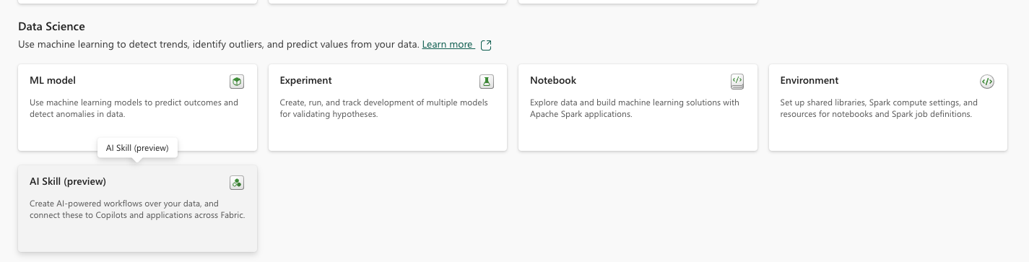
Fabric – Data Science assets

Slide 24
Ingest data
Task | Pandas (Python) | PySpark Pandas (Koalas)
Data Loading (100M rows) | Slower: Pandas reads data from a CSV or Parquet file into memory. Loading large datasets can result in high memory consumption and may even fail if the dataset is too large for the available RAM. | Faster: PySpark Pandas is distributed and can load data faster by splitting the work across multiple nodes. Suitable for datasets exceeding memory limits of a single machine.
Filtering (e.g., amount > 500) | Fast for smaller datasets, but performance degrades as the dataset size grows (100M rows may take time). Single-threaded operation. | Significantly faster as operations are distributed across nodes. Spark’s parallelism optimizes filtering, even on large datasets.
Grouping and Aggregation | Performance drops on large datasets due to memory limitations and single-threaded execution. Pandas groups and aggregates data in memory. | Spark-based grouping and aggregation are highly optimized for distributed computing, leading to faster performance even with massive datasets.
Adding New Columns | Quick for small-to-medium datasets but slower for larger datasets due to memory limits. | More efficient when scaling because operations are distributed across the cluster. Adding new columns is faster with large datasets.
Handling Null Values | Quick for small datasets, but performance suffers with large datasets. | Spark handles missing values efficiently at scale, outperforming Pandas for larger datasets.
Benchmark and Comparison

Slide 25
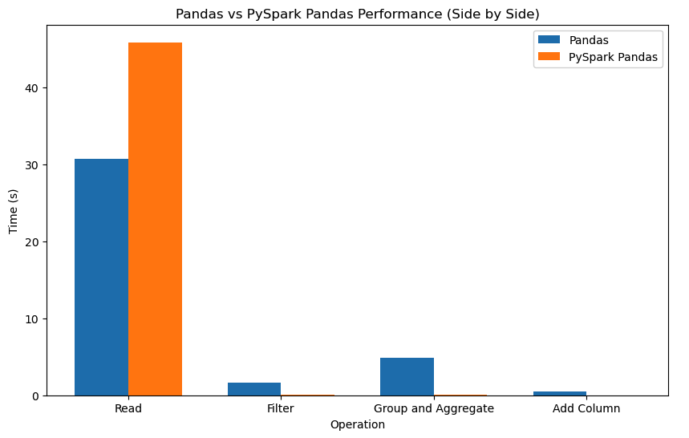
Ingest data
Pandas is optimized for small to medium datasets, working best on single machines with data that fits in memory. It has a more intuitive API but struggles when handling datasets exceeding a few million rows due to memory and CPU limitations.
PySpark Pandas (Koalas) is designed for distributed processing across clusters. This allows for faster data operations on large datasets. It is ideal for handling big data and scales out efficiently, making it faster than Pandas in most large-scale scenarios.
Benchmark and Comparison

Slide 26
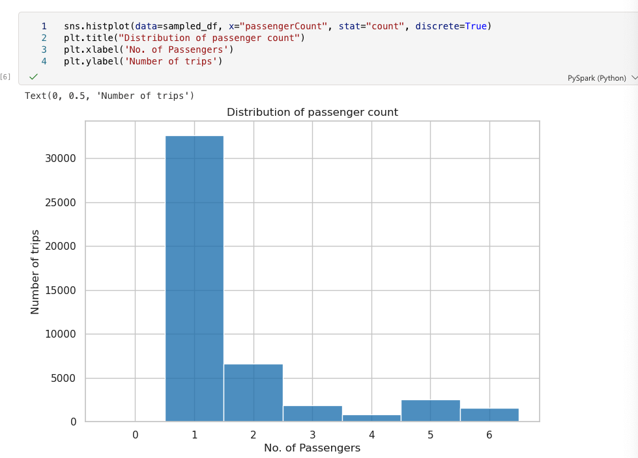
Explore and visualize data (EDA)

Slide 27
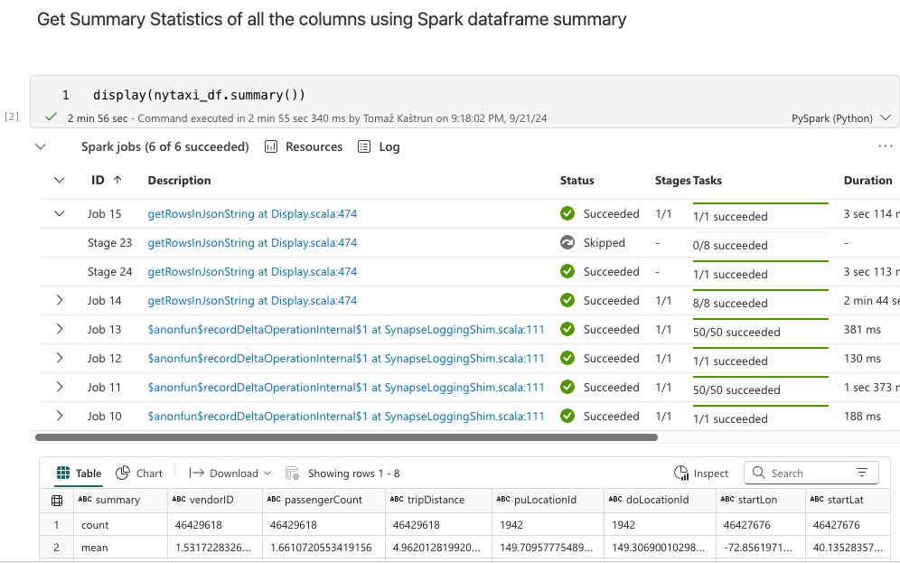
Data Cleaning and using Apache Spark

Slide 28
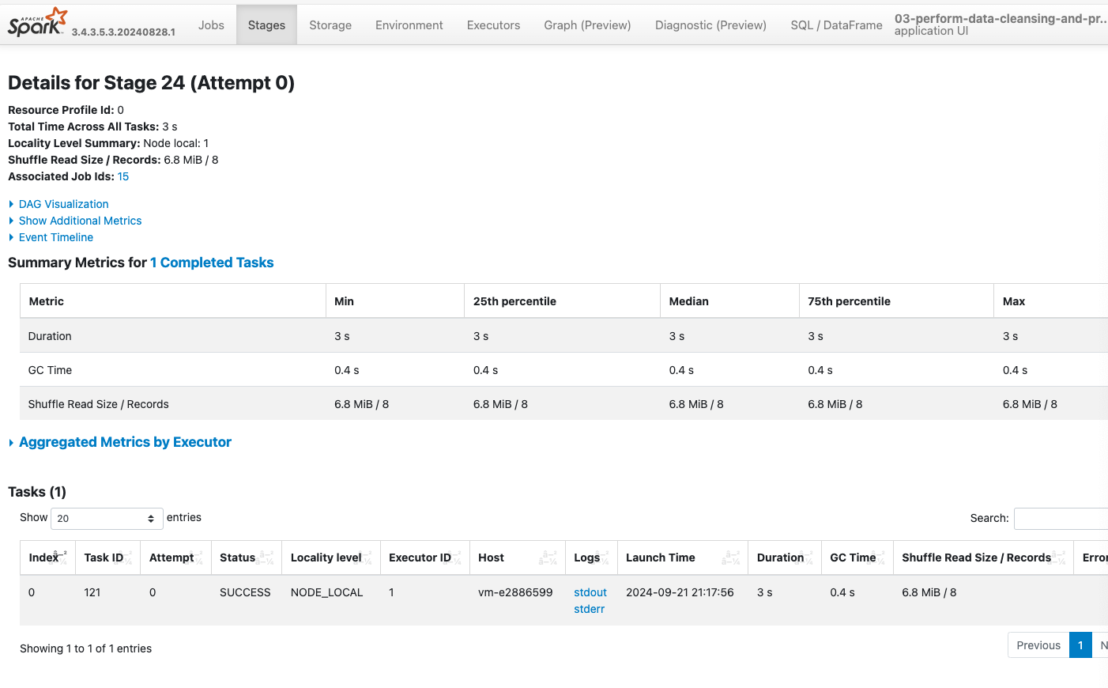

Slide 29
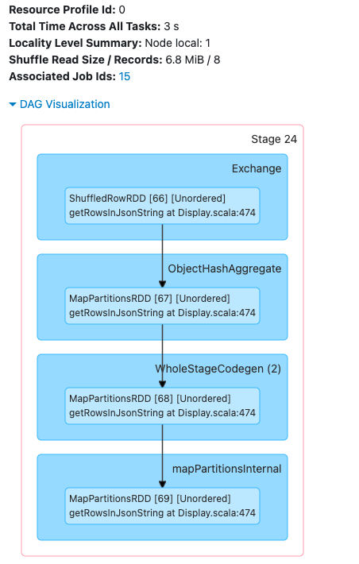
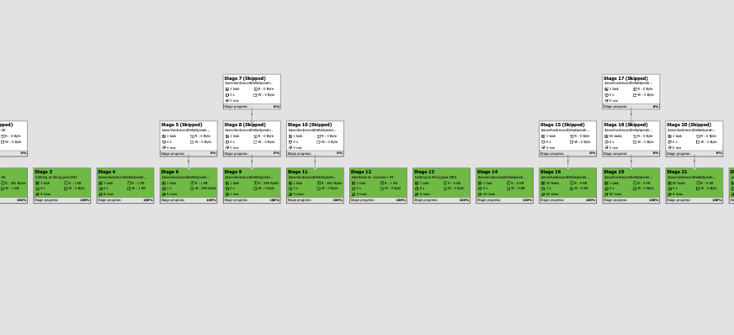

Slide 30
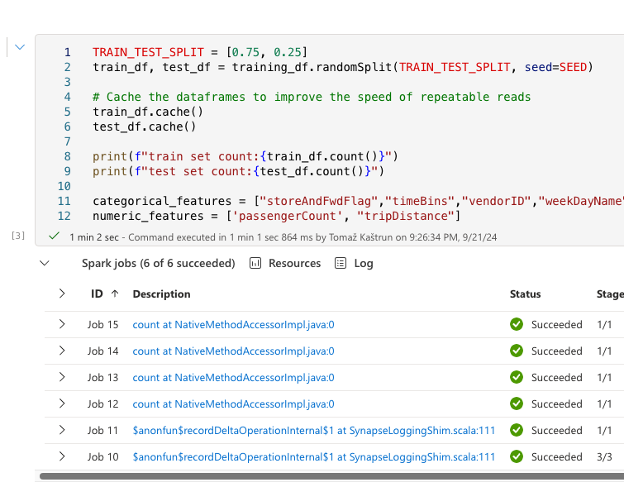
Model registratioin with MLFlow

Slide 31
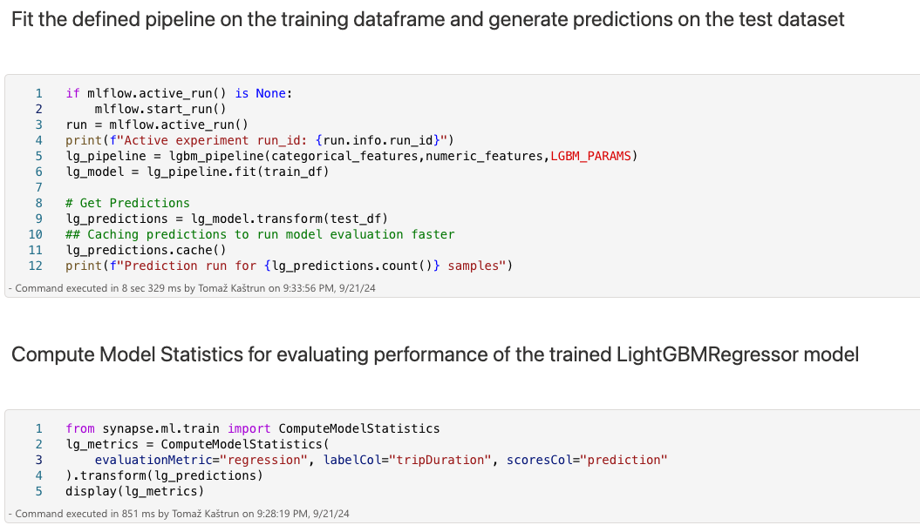
Model building

Slide 32
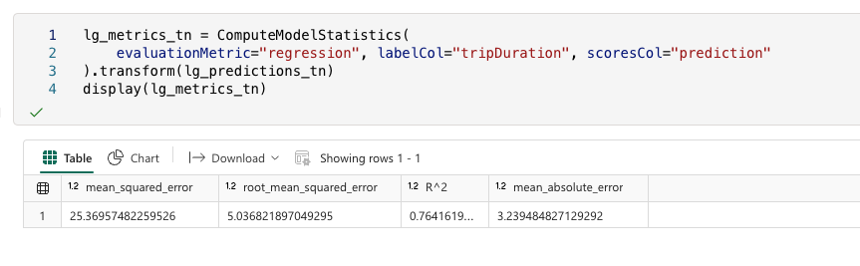
Model Assessment

Slide 33
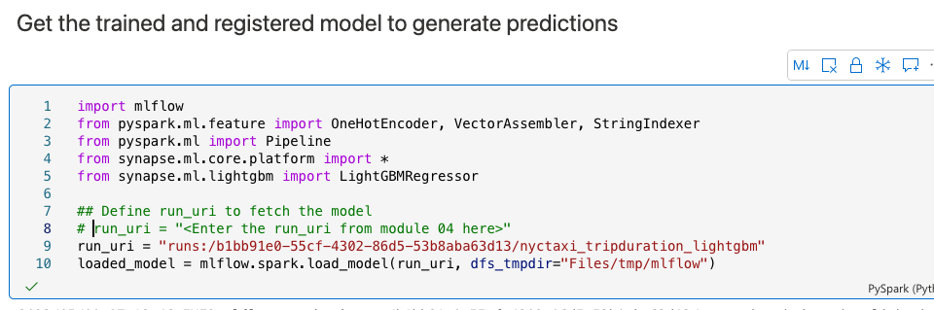
Model Consumption with API

Slide 34
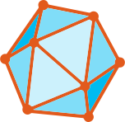
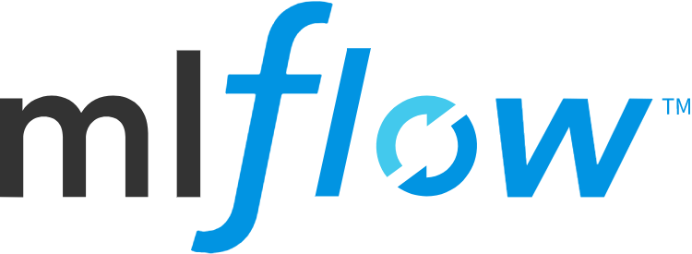
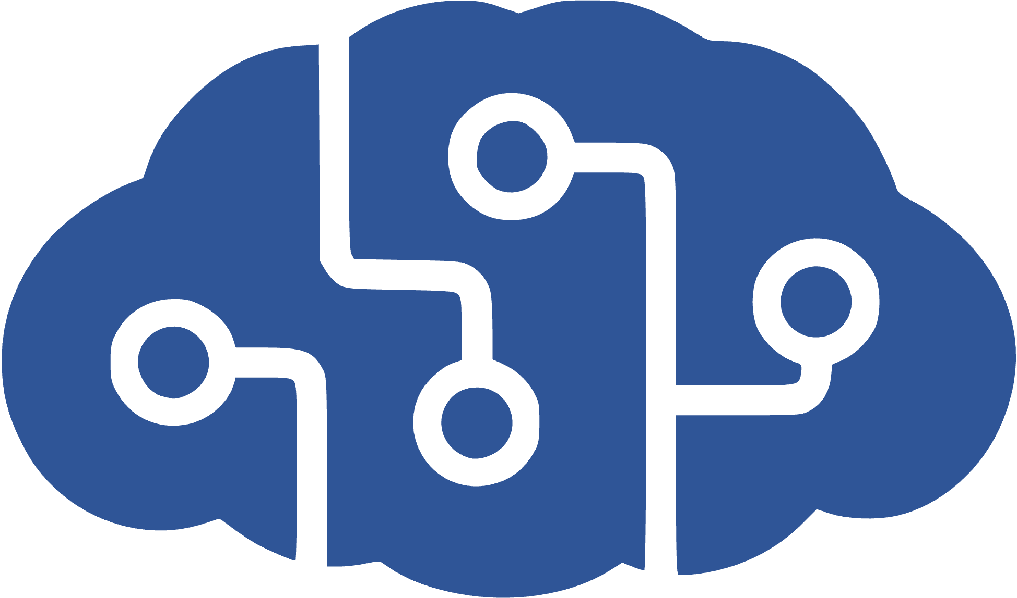
SynapseML and Microsoft AI services
SynapseML and Microsoft AI services
Distributed ML Model Training
MLflow support
Cognitive Services
OpenAI LLMs
Notes:
SynapseML is an open-source Apache Spark library for machine learning. It enables Machine Learning at scale with distributed training of models and support for MLFlow.
SynapseML includes integrations with ready to use Machine learning services like Azure Cognitive Services for vision, speech, language processing and translation.
It also includes support for Azure OpenAI to enable access to large language models that are fine tuned and ready to use without any pain.
And of course Microsoft Fabric will also be powered by AI. One of the most exciting upcoming features is the copilot experience, which will leverage natural language processing support to do analytics and generate data preparation tasks on Notebooks.

Slide 35
Thanks!

